Slide 1
Kinetics Lab (KIN) Phase II Presentation
Group Name: Just Diene (Group 6)
Instructor: Dr. Marat Orazov
Date: May 2nd, 2021
Group Members:
Daniel Robinson Abdul Fayeed Neel Shah Evan Sciacchitano

Slide 2
AGENDA
Introduction (Evan) ~ 2 minutes
Data Analysis ~ 10 minutes
Error Propagation (Dan)
Rate Orders (Abdul)
Arrhenius (Dan)
Current and Future Planning (Neel) ~ 3 minutes
Phase 3 organization

Slide 3
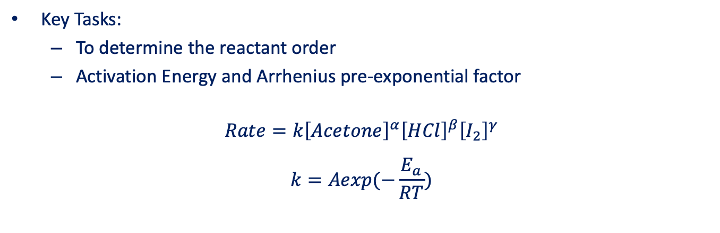
INTRODUCTION
Key Tasks:
To determine the reactant order
Activation Energy and Arrhenius pre-exponential factor
$$Rate=k{\left[Acetone\right]}^{α}{\left[HCl\right]}^{β}{\left[I_{2}\right]}^{γ}$$
$$k=Aexp(−\frac{E_{a}}{RT})$$

Slide 4
DATA ANALYSIS

Slide 5
RUNS CONDITIONS
Run # | Temperature (°C) | [Acetone]₀ (M) | [HCl]₀ (M) | [I₂]₀ (M)
1 | 35 | 2 | 0.02 | 0.0020
2 | 35 | 1 | 0.02 | 0.0020
3 | 35 | 3 | 0.02 | 0.0020
4 | 35 | 4 | 0.02 | 0.0020
5 | 35 | 2 | 0.01 | 0.0020
6 | 35 | 2 | 0.03 | 0.0020
7 | 35 | 2 | 0.04 | 0.0020
8 | 35 | 2 | 0.02 | 0.0010
9 | 35 | 2 | 0.02 | 0.0030
10 | 35 | 2 | 0.02 | 0.0040
11 | 30 | 2 | 0.02 | 0.0020
12 | 33 | 2 | 0.02 | 0.0020
13 | 40 | 2 | 0.02 | 0.0020
14 | 38 | 2 | 0.02 | 0.0020
14 runs
1 standard run
3 runs with varying concentration for each reactant
4 runs with varying temperature

Slide 6
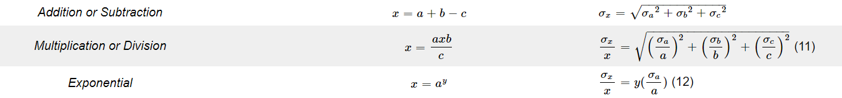

ERROR PROPAGATION
Errors in mass, absorbance, and temperature were propagated
Sources: Spectrophotometer, Thermocouple, and Balance
Reaction Orders – Method of Initial Rates
k – rate expression
Errors in regression: slope and intercept
Rate – Least Squares
E_{a} & A – sum of squares
$$k=\frac{r_{0}}{{\left[Acetone\right]}^{α}{\left[HCl\right]}^{β}{\left[I_{2}\right]}^{γ}}$$

Slide 7
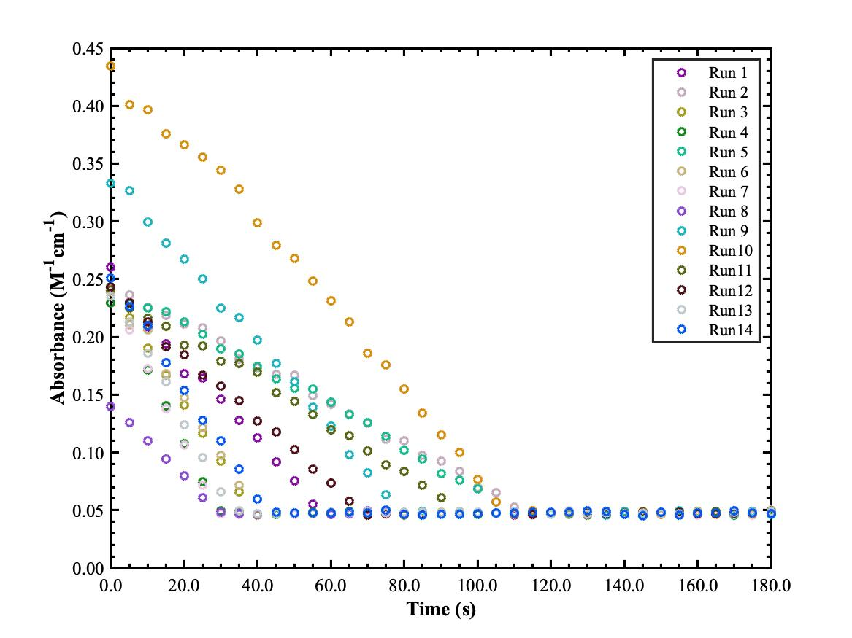
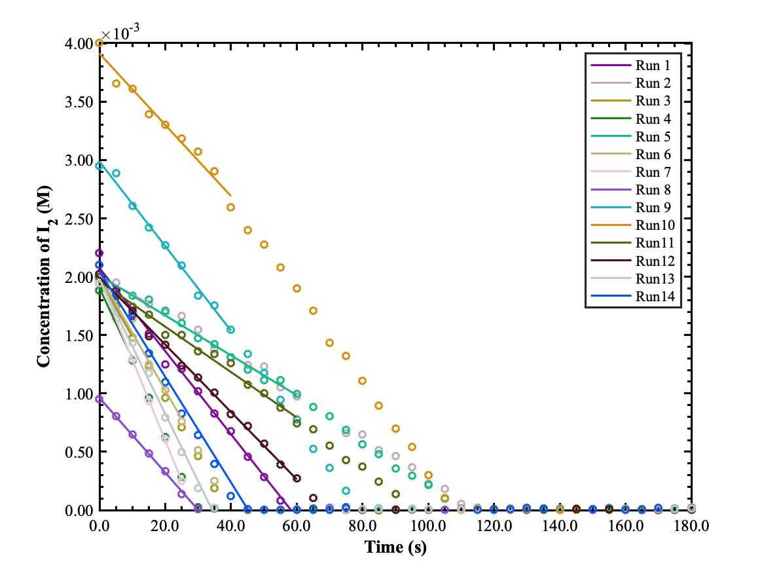
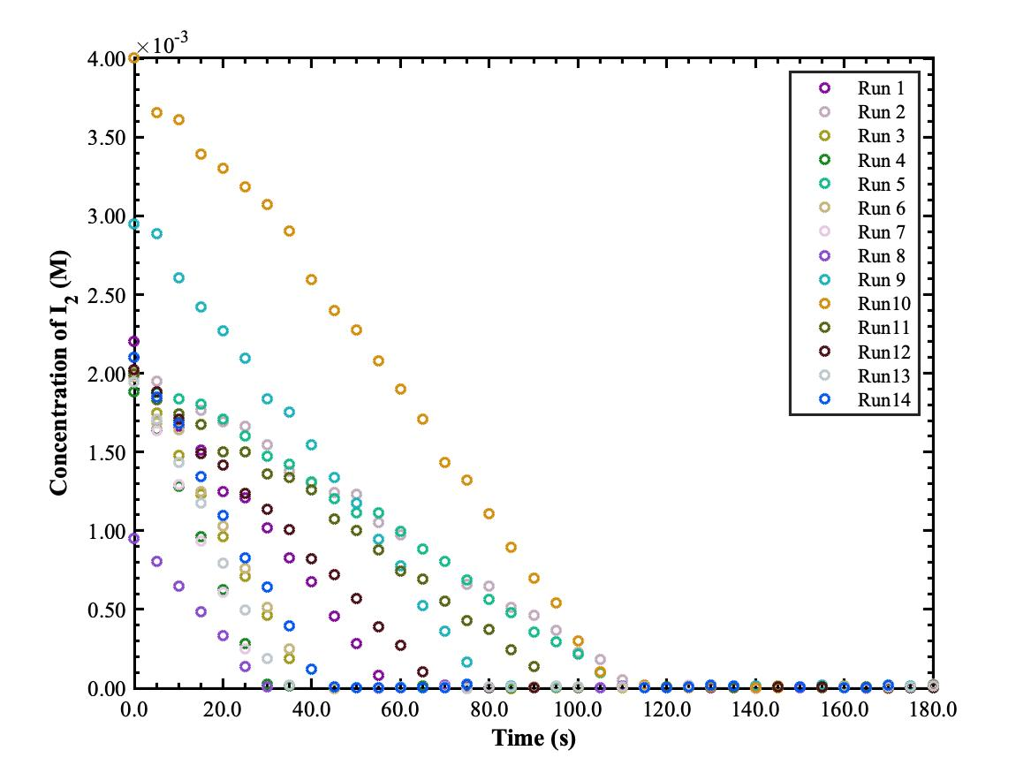
INITIAL RATE METHOD

Slide 8
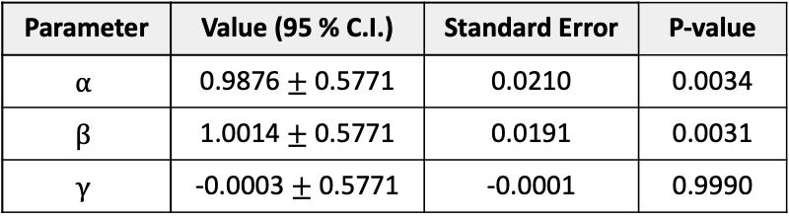
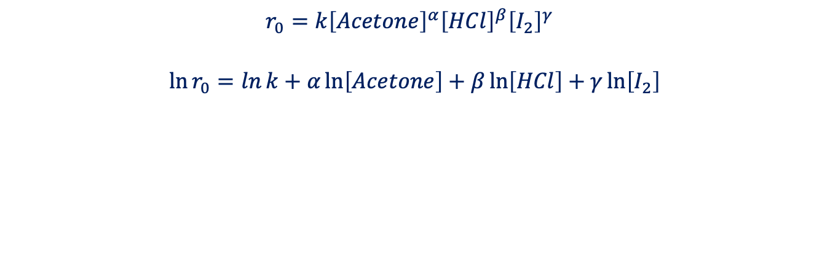
REACTION ORDERS ª
$$r_{0}={k\left[Acetone\right]}^{α}{\left[HCl\right]}^{β}{\left[I_{2}\right]}^{γ}$$
$$\ln{r_{0}}=\ln{k}+α\ln\left[Acetone\right]+β\ln\left[HCl\right]+γ\ln\left[I_{2}\right]$$
Parameter | Value (95 % C.I.) | Standard Error | P-value
$$α$$ | 0.9876 $±$ 0.5771 | 0.0210 | 0.0034
$β$ | 1.0014 $±$ 0.5771 | 0.0191 | 0.0031
$$γ$$ | -0.0003 $±$ 0.5771 | -0.0001 | 0.9990
ª See Supplementary A for detailed work
Notes:
USE MULTIPLE LINEAR REGRESSIONS
Didn’t do linear regressions on runs with varying a specific reactant to find the reaction order for that species, cuz it will create bias towards that reactants, since we didn’t consider all run at once
So to eliminate that bias, do multiple linear regressions all at once instead

Slide 9
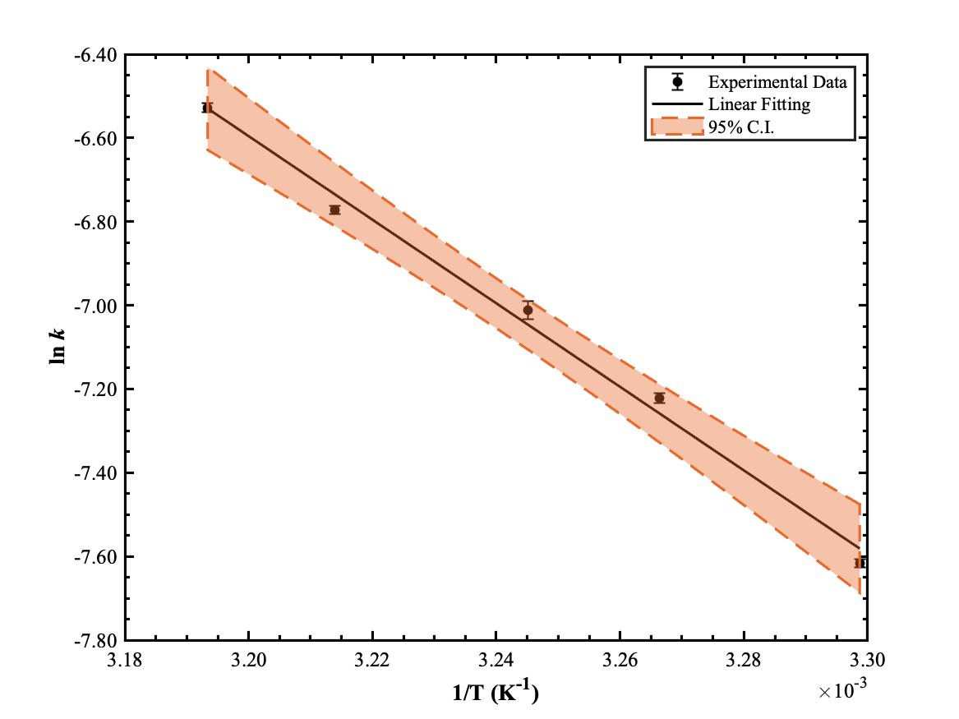

ARRHENIUS PLOT
$$\ln{k}=−\frac{E_{a}}{R}⋅\frac{1}{T}+\ln{A}$$
Parameter | Values | 95% Confidence Interval | P-value
A (M⁻¹s⁻¹) | 1.026x10¹¹ | 5.951x10⁸ - 1.769x10¹³ | 0.0006
Ea (kJ/mol) | 83.0101 | 69.8104 - 96.2098 | 0.0003

Slide 10
PHASE III PLANNING

Slide 11
PLAN FOR PHASE 3
Conduct Simulation and sensitivity analysis
Establish species balances to solve for the system of ODEs
Add iodine regeneration to Iodine balance
Model a batch reactor and CSTR
Analyze data and improve design
Finalize Report

Slide 12
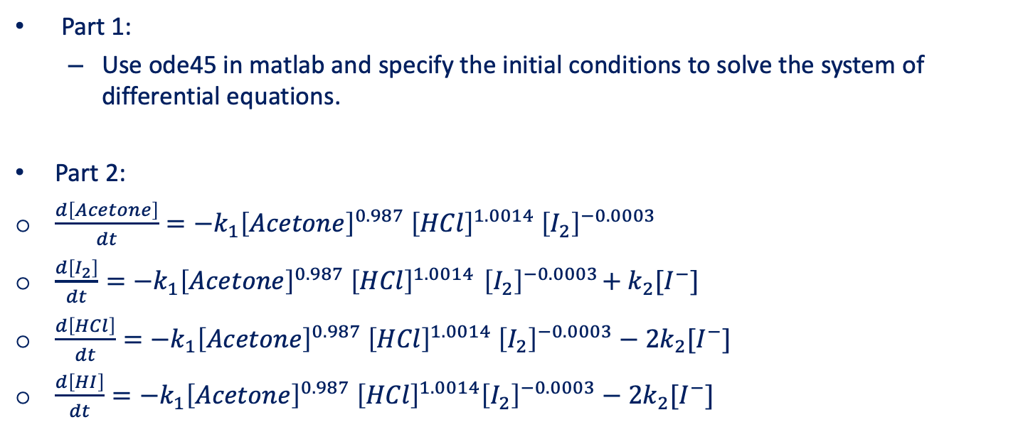
PLAN FOR PHASE 3 (cont’d)
Part 1:
Use ode45 in matlab and specify the initial conditions to solve the system of differential equations.
Part 2:
$\frac{d\left[Acetone\right]}{dt}=−k_{1}{\left[Acetone\right]}^{0.987} {\left[HCl\right]}^{1.0014} {\left[I_{2}\right]}^{−0.0003}$
$\frac{d\left[I_{2}\right]}{dt}=−k_{1}{\left[Acetone\right]}^{0.987} {\left[HCl\right]}^{1.0014}{ \left[I_{2}\right]}^{−0.0003}+k_{2}[I^{−}]$
$\frac{d\left[HCl\right]}{dt}=−k_{1}{\left[Acetone\right]}^{0.987} {\left[HCl\right]}^{1.0014} {\left[I_{2}\right]}^{−0.0003}−2k_{2}[I^{−}]$
$\frac{d\left[HI\right]}{dt}=−k_{1}{\left[Acetone\right]}^{0.987} {\left[HCl\right]}^{1.0014}{\left[I_{2}\right]}^{−0.0003}−2k_{2}[I^{−}]$

Slide 13
TIME MANAGEMENT PLAN
Week 5, Monday, 5/03/21:
Create MATLAB and/or ASPEN Models – Neel and Abdul
Week 6, Monday, 5/10/21:
Prepare Final Report and Presentation – Everyone
Week 7, Monday, 5/17/21:
Revise Final Report – Everyone

Slide 14
THANK YOU!

Slide 15
SUPPLEMENTARY A: Multiple Linear Regression
Run # | Initial Rate, r₀ (M/s) | u_{r0} (M/s) | [Acetone]₀ (M) | [HCl]₀ (M) | [I₂]₀ (M) | ln r₀ | ln [Acetone]₀ | ln [HCl]₀ | ln [I₂]₀
1 | 3.5604E-05 | 9.1040E-07 | 2.000 | 0.020 | 0.0020 | -10.2431 | 0.6931 | -3.9120 | -6.2146
2 | 1.5291E-05 | 2.0312E-06 | 1.000 | 0.020 | 0.0020 | -11.0882 | 0.0000 | -3.9120 | -6.2146
3 | 4.9796E-05 | 2.4805E-06 | 3.000 | 0.020 | 0.0020 | -9.9076 | 1.0986 | -3.9120 | -6.2146
4 | 6.0234E-05 | 6.8145E-06 | 4.000 | 0.020 | 0.0020 | -9.7173 | 1.3863 | -3.9120 | -6.2146
5 | 1.7092E-05 | 5.0035E-07 | 2.000 | 0.010 | 0.0020 | -10.9769 | 0.6931 | -4.6052 | -6.2146
6 | 4.9220E-05 | 3.5715E-06 | 2.000 | 0.030 | 0.0020 | -9.9192 | 0.6931 | -3.5066 | -6.2146
7 | 6.9323E-05 | 3.4030E-07 | 2.000 | 0.040 | 0.0020 | -9.5767 | 0.6931 | -3.2189 | -6.2146
8 | 3.2025E-05 | 5.4560E-07 | 2.000 | 0.020 | 0.0010 | -10.3490 | 0.6931 | -3.9120 | -6.9078
9 | 3.6251E-05 | 1.1631E-06 | 2.000 | 0.020 | 0.0030 | -10.2250 | 0.6931 | -3.9120 | -5.8091
10 | 3.0549E-05 | 1.9934E-06 | 2.000 | 0.020 | 0.0040 | -10.3962 | 0.6931 | -3.9120 | -5.5215
11 | 1.9456E-05 | 6.4025E-07 | 2.000 | 0.020 | 0.0020 | -10.8474 | 0.6931 | -3.9120 | -6.2146
12 | 2.8866E-05 | 4.5988E-07 | 2.000 | 0.020 | 0.0020 | -10.4529 | 0.6931 | -3.9120 | -6.2146
13 | 5.7767E-05 | 1.6237E-06 | 2.000 | 0.020 | 0.0020 | -9.7591 | 0.6931 | -3.9120 | -6.2146
14 | 4.5263E-05 | 1.8942E-06 | 2.000 | 0.020 | 0.0020 | -10.0030 | 0.6931 | -3.9120 | -6.2146
Regression Statistics
Multiple R | 0.86301
R² | 0.74478
Adjusted R² | 0.66821
Standard Error | 0.27330
Observations | 14
ANOVA
Parameter | df | SS | MS | F | Significance F
Regression | 3 | 2.17959 | 0.72653 | 9.72718 | 0.00260
Residual | 10 | 0.74691 | 0.07469
Total | 13 | 2.92650
Parameter | Coefficients | Standard Error | t Stat | P-value | Lower 95% | Upper 95%
Intercept | -7.0739 | 1.9086 | -3.7063 | 0.0041 | -11.3266 | -2.8213
ln [Acetone]₀ | 0.9876 | 0.2590 | 3.8129 | 0.0034 | 0.4105 | 1.5647
ln [HCl]₀ | 1.0014 | 0.2590 | 3.8662 | 0.0031 | 0.4243 | 1.5785
ln [I₂]₀ | -0.0003 | 0.2590 | -0.0012 | 0.9990 | -0.5774 | 0.5768

